Slide 1





MEDICINAL PLANTS
GE19612 - PROFESSIONAL READINESS FOR INNOVATION, EMPLOYABILITY AND ENTREPRENEURSHIP
TO IDENTIFY THE MEDICINAL PLANTS USING IMAGE PROCESSING
KAVIN MANOHARAN(210701114) KAARNESH V S(210701100)
VENKATESH V (210701520)
PROJECT COORDINATOR:
K. Anand , M.E ,Ph.D
Assistant Professor(SG) DEPARTMENT OF COMPUTER SCIENCE AND ENGINEERING

Slide 2
Abstract
This project focuses on the development of advanced image processing software leveraging
machine learning techniques to accurately identify medicinal plants. The objective is to
enhance the authenticity and ensure the integrity of the medicinal plant supply chain. By
utilizing a comprehensive database of medicinal plant images, the software uses Machine
Learning(ML) to analyze and recognize plant species based on their visual characteristics.
This innovative approach is to improve the reliability of sourcing and verifying medicinal
plants. The system offers a user-friendly interface for real-time plant identification and
includes features for recording and tracking plant authenticity throughout the supply chain.
The implementation of this technology promises to benefit botanists, herbalists, and
suppliers by providing a robust tool for maintaining the quality and traceability of medicinal
plant products.

Slide 3
Problem Statement
The problem faced by the people identifying medicinal plants are that they need to consult
experts to find the right medicinal plant for their disease. This might often lead to errors.
Inorder to avoid such errors we are going to implement image processing using Machine
Learning(ML) to identify the right medicinal plant accurately thereby enhancing
authenticity and ensuring integrity of the medicinal plant supply chain.

Slide 4
Existing System
The existing system for identifying medicinal plants typically relies on traditional methods, such as manual identification by experts, which is time-consuming and prone to human error. Botanical specialists use physical characteristics and taxonomic keys to differentiate between species, often requiring in-depth knowledge and experience. In some cases, reference books and online databases are used to support identification, but these resources can be cumbersome to navigate and may not always provide accurate or comprehensive information. Additionally, there is a lack of integration with modern technologies, which limits the efficiency and scalability of the process. As a result, ensuring the authenticity and integrity of medicinal plants in the supply chain remains a significant challenge, highlighting the need for a more advanced and automated solution.
4

Slide 5
Proposed System
The suggested technique develops software to precisely identify medicinal plants by utilizing machine learning and image processing. In order to precisely recognize different species of plants, this sophisticated system combines powerful algorithms with high-resolution photography to assess plant properties. The program matches photos to recognized species, guaranteeing precise identification, by drawing on a large database of therapeutic plants. For simple engagement and instantaneous response, the system has an intuitive user interface. In addition, customers can identify plants on-site by accessing the program using mobile devices. Throughout the supply chain, this automated method not only guarantees the integrity and authenticity of medicinal plants but also improves the efficiency and accuracy of plant identification. Through the integration of machine learning, the system consistently enhances its precision and flexibility, rendering it a valuable tool.

Slide 6
Aim and Objectives
Aim:
This project's main goal is to create cutting-edge image processing software that
correctly identifies medicinal plants by applying machine learning techniques. This will
improve the supply chain's authenticity and integrity.
Objectives:
A large dataset of photos of medicinal plants must be gathered and annotated, machine learning models must be developed and optimized for high-precision plant identification, and an intuitive software must be made to enable smooth picture processing. To improve authenticity and integrity, the software will be linked into the current
supply chains for medicinal plants. It will also be extensively tested and validated in a 3
range of scenarios, and it will be updated frequently to take new plant species and
technological developments into account.

Slide 7
Literature Survey
The study by J. Samuel Manoharan focuses on the detection of herbal plant
leaves using a machine learning classifier and two-stage authentication procedure.
The algorithm addresses incomplete problems in datasets, improving the detection
rate and minimizing classification errors. The inclusion of dimension factors in
datasets and intelligent selection of image segmentation techniques further enhance
the detection accuracy.

Slide 8
Literature Survey
A global medical emergency affecting all facets of human life has been
brought on by the COVID-19 pandemic. Since December 2019, the virus has
severely impacted countries with weak health systems and slow responses, causing
multiple fatalities . Machine learning has been used in many healthcare applications,
including thyroid diagnosis, fetal localization, lung nodule classification, and
diabetic retinopathy detection. Deep learning is an excellent method to stop the
outbreak since it can be used to a variety of medical imaging sources, including CT,
MRI, and X-ray images.

Slide 9
Literature Survey
This study presents a deep learning-based methodology for classifying
medicinal plant leaves for types and diseases using a dataset created from plant
leaves in ten categories. The model uses seven pre-learning deep learning algorithms
and an image data set created from plant leaves in ten categories. The proposed
model classifies the plant type and diseased condition in the dataset. The test
accuracy rate of 98.69% was achieved with the DenseNet121 model, and at the last
stage, after edge detection processes, the test accuracy value of 67.92% was reached
with the DenseNet 121 model. This method is important for traditional medicine and
pharmaceutical industry, as it helps identify diseases early and accurately.

Slide 10
Hardware & Software Requirements
Desktop/Laptop Computers:
Processor: 11th Gen Intel(R) Core(TM) i5
RAM: 8GB or higher
Storage: 128GB SSD or higher
Display: 15-inch monitor or larger
OS: Windows 11
Development Environment:
Programming Language: Python
Development Tools: Visual Studio Code
Libraries and Framework:Tensorflow
Version Control: GitHub

Slide 11
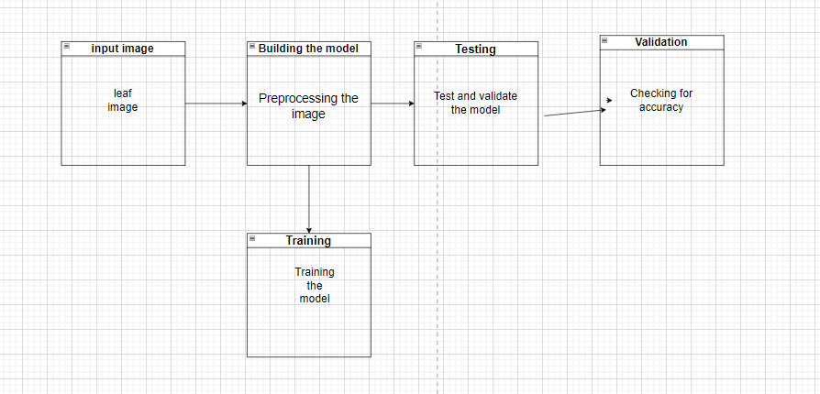
Architecture Diagram

Slide 12
Module Description
The project to develop image processing software for identifying medicinal
plants using machine learning can be divided into several essential modules. First, the
Data Collection and Management module handles the sourcing, labeling, and storage
of plant images and related metadata. The Image Preprocessing module prepares raw
images by cleaning, enhancing, and standardizing them, while the Feature Extraction
module applies algorithms to generate significant feature vectors. The Machine
Learning Model Development module focuses on training and fine-tuning models,
and the User Interface module provides functionalities for image uploads and result
displays. Backend Integration ensures smooth communication between the user
interface and machine learning models. The Testing and Validation module
guarantees that the software meets all requirements through rigorous testing.
Deployment and Maintenance handle software deployment and ongoing updates.
Comprehensive documentation and user training are facilitated through the
Documentation and Training module, while the Feedback and Improvement module
collects user feedback for continuous enhancement. This structured approach ensures
a robust and user-friendly application for enhancing authenticity and integrity in the
medicinal plant supply chain.

Slide 13
Sample coding
ML Model Testing Code:
import numpy as np
from keras.preprocessing import image
from keras.models import load_model
model = load_model('C:\Personal\Kavin\PRIEE
Project\Jupyter_notebooks\model_path\model.h5')
img_path = 'C:\Personal\Kavin\PRIEE Project\Jupyter_notebooks\Aloevera.jpg'
img = image.load_img(img_path, target_size=(100, 100))
img_array = image.img_to_array(img)
img_array = np.expand_dims(img_array, axis=0)
img_array /= 255.
predictions = model.predict(img_array)
class_labels = ['Aloevera', 'Amla', 'Amruthaballi', 'Arali', 'ashoka', 'Astma_weed',
'Badipala', 'Balloon_Vine', 'Bamboo', 'Beans', 'Betel', 'Bhrami', 'Bringaraja', 'camphor',
'Caricature', 'Castor']
predicted_class_index = np.argmax(predictions)
print("Predicted index:", predicted_class_index)
predicted_label = class_labels[predicted_class_index]
print("Predicted label:", predicted_label)

Slide 14
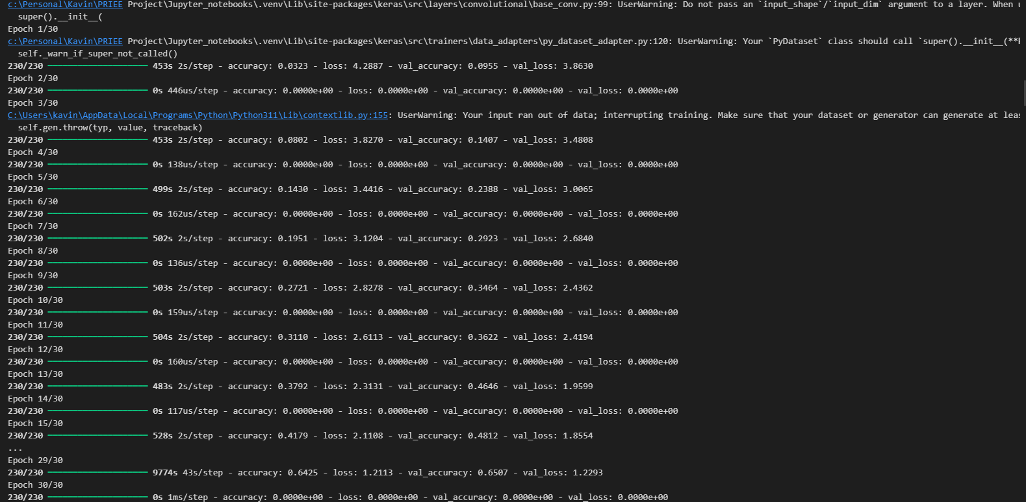
Outputs and Final Results
TRAINING

Slide 15
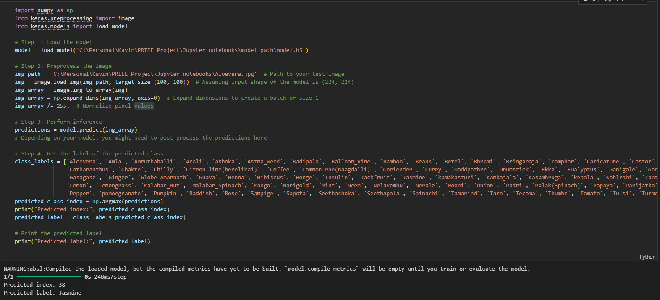
Outputs and Final Results
TESTING

Slide 16
Conclusion
The development of the image processing software using machine learning for
identifying medicinal plants successfully addressed the need for accurate and efficient plant
identification in the medicinal plant supply chain. The system demonstrated high accuracy in
recognizing various medicinal plants, significantly enhancing the authenticity and integrity
of plant identification. The integration of advanced image preprocessing techniques and
machine learning algorithms ensured reliable performance, while the user-friendly interface
facilitated ease of use for practitioners and suppliers. This project not only improves the
quality control of medicinal plants but also reduces the risk of misidentification, promoting
safety and trust in the industry.

Slide 17
Future Enhancements
Firstly, expanding the database to
include a wider variety of medicinal plants would increase the system's applicability
and accuracy. Integrating real-time data processing capabilities would allow users to
receive instant feedback and results, making the software more efficient and practical in
real-world scenarios. Additionally, improving the robustness of the machine learning
algorithms to account for environmental variations, such as different lighting
conditions, backgrounds, and plant growth stages, would enhance the reliability of the
system. Another potential enhancement is the inclusion of a more comprehensive user 20
interface that offers detailed plant information, usage guidelines, and potential
applications, providing users with a richer and more informative experience.

Slide 18
References
[1] Manoharan, J. Samuel. "Flawless detection of herbal plant leaf
by machine learning classifier through two stage authentication
procedure." Journal of Artificial Intelligence and Capsule Networks 3.2
(2021): 125-139.
[2] Bhattacharya, Sweta, et al. "Deep learning and medical image
processing for coronavirus (COVID-19) pandemic: A survey."
Sustainable cities and society 65 (2021): 102589.
[3] Gajjar, Viraj K., Anand K. Nambisan, and Kurt L. Kosbar.
"Plant Identification in a Combined-Imbalanced Leaf Dataset." IEEE
Access 10 (2022): 37882-37891.

Slide 19
Thank You

